Slide 1



Macroeconomic Models: Understanding the Big Picture
A Comparative Overview of Classical, Keynesian Cross, and IS-LM Models
BY
MANASA D N (1RV22CS104)
Prof. Sandhya S
Associate Professor
Dept of CSE,RVCE

Slide 2
Table of contents
01
INTRODUCTION
02
THE CLASSICAL MODEL
03
THE KEYNESIAN CROSS MODEL
04
THE IS-LM MODEL
05
COMPARISION OF THE MODELS
06
CONCLUSION

Slide 3
01
INTRODUCTION

Slide 4





WHY MODELS MATTER
Definition :-
Macroeconomic models simplify complex economic realities, helping to understand key relationships and predict outcomes.
Important Macroeconomic Models
Classical Model
Keynesian Cross
IS-LM Model

Slide 5
EVOLUTION OF MACROECONOMIC MODELS
Keynesian Cross
18th-19th Century
1930s-40s
1930
Classical Model
IS-LM Model

Slide 6
The Classical Model
02

Slide 7
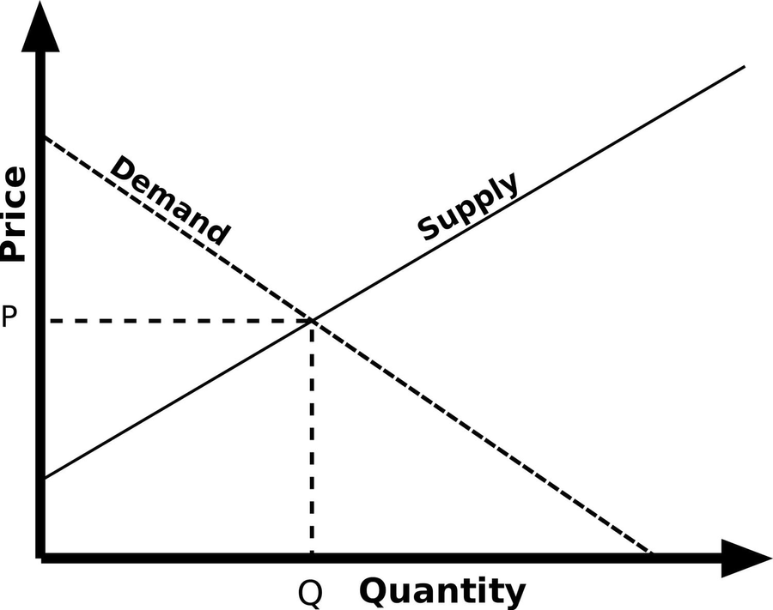

Core Assumptions
Flexible prices and wages ensure full employment.
Minimal government intervention
Key Focus of Classical Model:
LONG-RUN EQUILIBRIUM
POTENTIAL OUTPUT

Slide 8

A SIMPLE ANALOGY
The farmers' market illustrates the Classical Model well. In a farmers' market, if there is excess supply of vegetables, sellers lower prices to attract buyers, ensuring everything gets sold. If demand is high and supply is low, prices rise, encouraging more sellers to enter the market.
THE FARMER’S MARKET
Similarly, the Classical Model assumes that flexible prices and wages allow markets to self-correct, leading to full employment and efficient resource allocation.

Slide 9
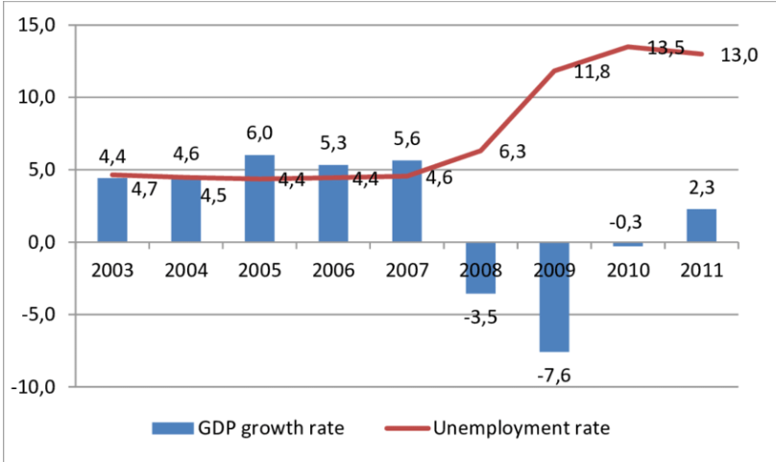

LIMITATIONS OF THE CLASSICAL MODEL
CHALLENGES
Fails to explain prolonged recessions or unemployment.
The Great Depression disproved its self-correcting assumption
rapid price adjustments didn’t lead to immediate recovery as shown in the above graph.
2008 Financial Crisis

Slide 10
The Keynesian Cross Model
03

Slide 11
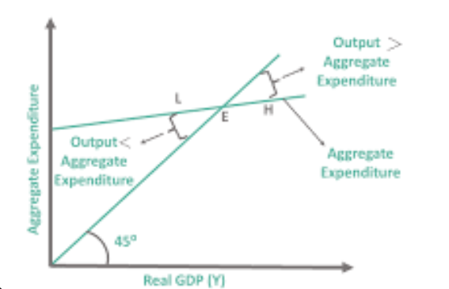
Core Assumptions
Flexible prices and wages ensure full employment.
Minimal government intervention
Key Focus of Keynesian Cross Model :
SHORT-RUN EQUILIBRIUM
AGGREGATE DEMAND DRIVES OUTPUT

Slide 12
A SIMPLE ANALOGY
When a small business invests in new equipment, it creates income for the equipment supplier. The supplier, in turn, spends this income on wages, materials, and other expenses, which further circulates money in the economy. Thus this analogy explains the Keynesian Cross Model and the Multiplier Effect.
SMALL BUSINESS INVESTMENTS
This ripple effect demonstrates how aggregate demand drives output in the short run. Keynesian economics argues that increased spending leads to higher income and employment, especially during recessions, justifying government intervention to stimulate demand.

Slide 13
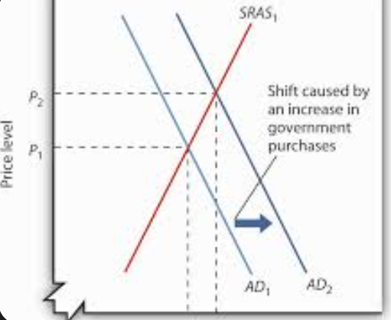
GOVERNMENT INTERVENTION IN THE KEYNESIAN CROSS MODEL
Role of Fiscal Policy
Government spending and taxation influence demand.
Massive stimulus packages, including direct payments, unemployment benefits, and business loans, were implemented to sustain household income and economic activity
Counter-cyclical measures stabilize the economy
COVID-19 Relief

Slide 14
The IS-LM Model
04

Slide 15
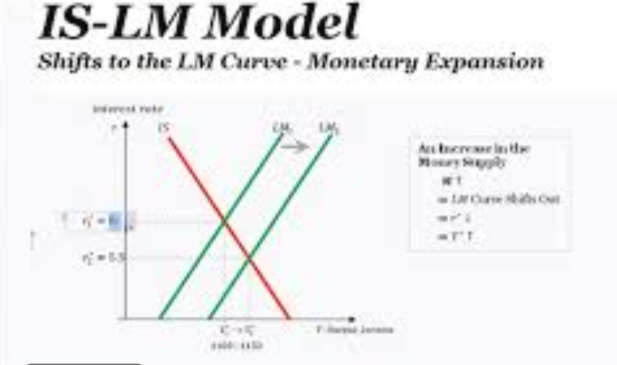


Concept
IS Curve: Equilibrium in the goods market.
LM Curve: Equilibrium in the money market.
Interaction determines interest rates and output.
Monetary & Fiscal Policy Impact
Interest rate adjustments influence investments and spending
Government intervention shifts the curves

Slide 16
A SIMPLE ANALOGY
fiscal policy (accelerator) and monetary policy (steering)
Just like driving requires both acceleration and steering, economic stability depends on a balance between fiscal and monetary policies to maintain optimal growth and employment.
ECONOMY AS A CAR
Fiscal Policy (Accelerator): Government spending and taxation control the speed of the economy. Increased spending or tax cuts accelerate growth, while spending cuts or tax hikes slow it down.
Monetary Policy (Steering Wheel): Central banks adjust interest rates and money supply to steer the economy in the right direction, ensuring stability and preventing inflation or recession.

Slide 17
Comparing the Models
05

Slide 18
Comparision Table
Feature | Classical Model | Keynesian Cross | IS_LM Model
Time Horizon | Long-run | Short-run | Short-run
Key Focusn | Supply-side | Demand-side | Both
Government Role | Minimal | Active | Mixed
Price Flexibility | Fully Flexible | Sticky Prices | Adjusts Gradually

Slide 19
CONCLUSION
06

Slide 20

CONCLUSION
Macroeconomic models serve as essential tools for understanding economic dynamics, yet they remain simplifications of reality. Each model—Classical, Keynesian Cross, and IS-LM—offers a unique perspective, helping economists and policymakers make informed decisions. However, as economies evolve, so must our models. Future economic frameworks will integrate behavioral insights, global interconnections, and technological advancements to enhance predictive accuracy.

Slide 21
Thank You

